Slide 1
ATOMIC ENERGY EDUCATION SOCIETY
SUBJECT – GEOGRAPHY
STREAM – ARTS
CLASS -12
CHAPTER- 10
HUMAN SETTLEMENTS
MODULE-01/02
Prepared By: Mr. S.SADHUKHAN (PGT-SS)
AECS-2, JADUGUDA

Slide 3
CLASSIFICATION OF SETTLEMENTS RURAL URBAN DICHOTOMY
RURAL |  | URBAN
1. | People living in villages pursue primary occupation- agriculture, fishing, lumbering, mining, animal husbandry, etc. | 1. | People living in town or city work in secondary and tertiary sector.
2. | Size of population is less | 2. | Size of population is high
3. | Standard of living is low and low source of income | 3. | Standard of living is high and high source of income
4. | Low density of population | 4. | High density of population
5. | Villages are widely spaced | 5. | Cities and towns are closely spaced

Slide 4
Urban Settlement-
All places which have municipality, corporation, cantonment board or notified town area committee and have a minimum population of 5000 persons, at least 75percent of male workers are engaged in non-agricultural pursuits and a density of population of at least 400 persons per square kilometers are urban.

Slide 5
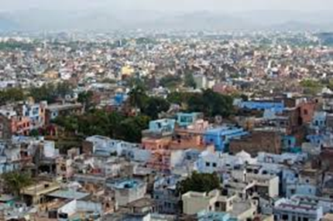
TYPES AND PATTERNS OF SETTLEMENTS
Compact or Nucleated settlement: These settlements are those in which large numbers of houses are built very close to each other. Such settlements develop along river valleys and in fertile plains.

Slide 6
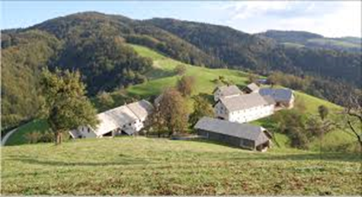
Dispersed Settlements or scattered settlement:
In these settlement houses are spaced far apart and often interspersed with fields. They are isolated huts

Slide 11
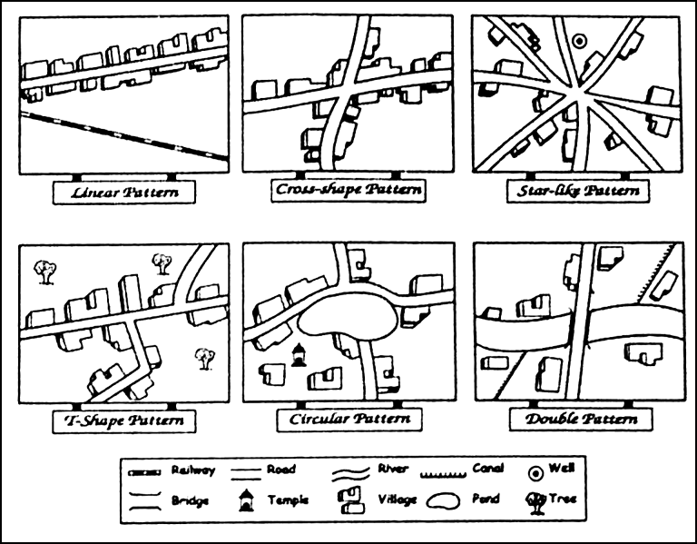

Slide 13
THANK YOU

